Slide 1



Introduction to Git for Version Control
This tutorial is aimed at Data Scientists and Statisticians
Presented by: Pavan Datta

Slide 2
Outline of Topics
What is Git? Why use Git?
Definition of Terms
Common and Useful Commands
Step-by-Step Walkthrough with Git
Live Tutorial + Setup Git/GitHub
References

Slide 3
1. What is Git? Why use Git?
A open source distributed version control system (DVCS)
Source code is available on a remote repository (GitHub / GitLab)
Source code can be cloned onto numerous local repositories
Lightweight, fast, and flexible
Most operations are performed locally
Git only stores differences between commits
Easily context switch between branches
Easily manage changes to files across large teams
Git keeps track of every change ever made
Multiple backups are supported
Many different workflow styles supported

Slide 4
1. What is GitHub? Why use GitHub?
GitHub is like Facebook, but for hosting code
With the right permissions, code sharing and collaboration are possible
Many R-packages are now available via GitHub
GitHub makes code collaborating easier than before
Supports many different workflow styles
Let’s check it out!

Slide 5
1. Flexible Workflow Styles Supported by Git
A
Subversion (SVN) style workflow
Integration Manager Workflow
Dictator and Lieutenants Workflow
B
C

Slide 6
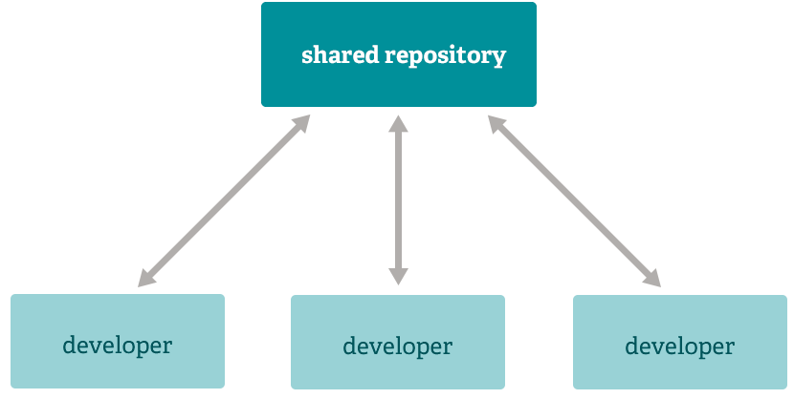
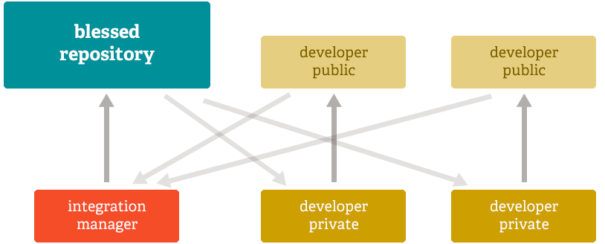
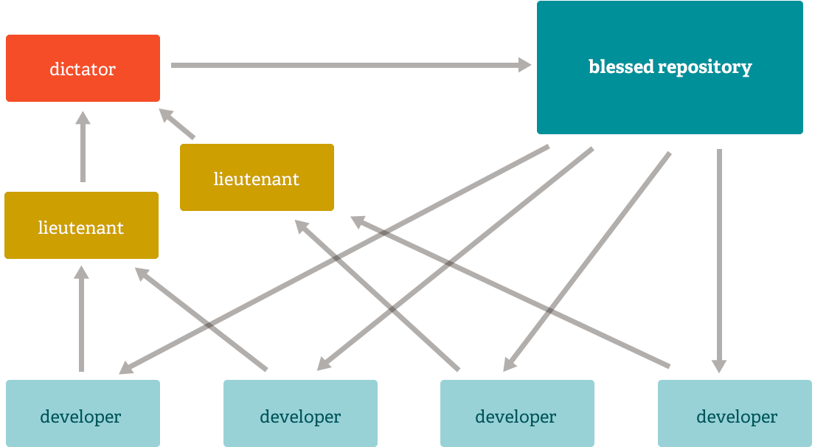
1. Flexible Workflow Styles Supported by Git
A
B
C

Slide 7
2. Definition of Terms
Repository – directory structure under which all files are stored for a project
Local Repository – the repository hosted locally on your computer system
All project contributors make their changes (commits) in their own local repositories
Remote Repository – the repository hosted remotely on GitHub / GitLab
All project contributors push their local changes (commits) to the remote repository
All project contributors pull changes (commits) from the remote repository into their local repositories
Branches – the different workflows or paths in a repository
Each repository has at least one branch (the default branch is called master)
Branches get sync’d between remote and local repositories
Branches can be created, deleted, and merged
Branches can be used as a playground for your changes so that they do not interfere with the master branch
Clone – the process of creating a local copy of a remote repository

Slide 8
2. Definition of Terms
Commit – a change (or snapshot in time)
Each branch consists of commits
Each commit has a unique SHA or hash (40 character checksum) by which it is identified
A commit considers only diffs or deltas from the previous commit
Checkout – the process of selecting a specific branch or commit (snapshot)
Pull – the process of fetching commits from the remote repository and merging the differences into the local repository
Fetch – get/copy commits from the remote repository, into the local repository
Merge – account for all differences between the local repository and remote repository
Push – send changes from the local repository to the remote repository
This is frequently preceded by a pull
Permissions in the remote repository may prevent you from performing a push and may instead require a formal pull-request (e.g. merge-request) through GitHub / GitLab

Slide 9
2. Definition of Terms (Visually)
head
Consider a remote repository with one branch
Dots represent commits
Small arrows represent pointers to commits
master
remote
local

Slide 10
2. Definition of Terms (Visually)
head
Consider a remote repository with one branch
Dots represent commits
Small arrows represent pointers to commits
Clone the remote repository locally
master
remote
local
head
master

Slide 11
2. Definition of Terms (Visually)
head
Consider a remote repository with one branch
Dots represent commits
Small arrows represent pointers to commits
Clone the remote repository locally
Create a new branch in the local repository
master
remote
local
head
master
mybranch

Slide 12
2. Definition of Terms (Visually)
head
Clone the remote repository locally
Create a new branch in the local repository
Make commits to the new branch
Head is a pointer the current commit in your workspace
master
remote
local
master
head
mybranch

Slide 13
2. Definition of Terms (Visually)
head
Create a new branch in the local repository
Make commits to the new branch
Head is a pointer the current commit in your workspace
Push all commits associated with the new branch to the remote repository
master
mybranch
remote
local
master
head
mybranch

Slide 14
2. Definition of Terms (Visually)
head
Make commits to the new branch
Head is a pointer the current commit in your workspace
Push all commits associated with the new branch to the remote repository
Merge the new branch into the master branch
master
mybranch
remote
local
head
master
mybranch

Slide 15
2. Definition of Terms (Visually)
head
Push all commits associated with the new branch to the remote repository
Merge the new branch into the master branch
Push all changes to the remote repository
master
mybranch
remote
local
head
master
mybranch

Slide 16
2. Definition of Terms (Visually)
head
Merge the new branch into the master branch
Push all changes to the remote repository
Suppose another developer pushes changes to the remote repository
master
mybranch
remote
local 1
local 2
head
master
mybranch

Slide 17
2. Definition of Terms (Visually)
head
Push all changes to the remote repository
Suppose another developer pushes changes to the remote repository
Fetch the new commits from the remote repository
master
mybranch
remote
local
head
master
mybranch

Slide 18
2. Definition of Terms (Visually)
head
Suppose another developer pushes changes to the remote repository
Fetch the new commits from the remote repository
Merge the differences in your local repository
master
mybranch
remote
local
head
master
mybranch

Slide 19
2. Snapshot of Git Repositories
head
master
mybranch
remote
local 1
local 2
local 3
head
head
master
master
master
mybranch
mybranch
mybranch
mybranch2
head

Slide 20
3. Navigating with Git
The process of promoting code/changes is as follows:
Source code changes made locally in workspace (Git is unaware)
Stage the files that changed (e.g. tell Git which files you want to commit)
Commit the files that changed to your local repository (Git is aware of changes)
Push changes from local repository to remote repository
All Git operations may be performed by command-line or using conveniently designed user-interfaces for your OS
This tutorial relies exclusively on the command-line approach
Used by most people in the user community
Well documented and easy to get help

Slide 21
3. Common and Useful Commands
> git clone <repo-location>:<user>/<repo-name>.git
Create a clone of the remote repository locally
> git remote -v
Check the remote repository and its alias
> git checkout <branch-name | commit-SHA>
Look at a particular branch or commit (sets the HEAD pointer)
> git checkout –b <branch-name>
Create a new branch and switch to it (sets the HEAD pointer to the new branch)

Slide 22
3. Common and Useful Commands
> git pull <remote-repo> <branch>
Fetch commits and merge differences from a branch in the remote repository
NOTE: Only state the remote repository and branch name if it isn’t already set
> git push <remote-repo> <branch>
Push commits to the remote repository and its respective branch
NOTE: Only state the remote repository and branch name if it isn’t already set
> git push –u <remote-repo> <branch>
Push a newly created branch to the remote repository
> git log –-oneline –n10
View the last 10 commits, with each commit taking up a single line

Slide 23
3. Common and Useful Commands
> git status
Check the status of tracked files, staged files, and files ready for commit
> git add <file(s)>
Stages files for commit
> git commit –m “<Commit message>”
Commits all staged files with the specified commit message
Preceded by the add command
> git revert <commit-hash>
Revert or undo a commit
NOTE: This adds a new commit to undo a previous commit

Slide 24
3. Common and Useful Commands
> git diff <commit-hash-1> <commit-hash-2>
Visually see the differences between two commits
If only one commit-hash is provided, then run diff against the HEAD commit
If no commit-hash is provided, then run diff against the
> git diff –-stat <commit-hash-1> <commit-hash-2>
List the files that differ between two commits

Slide 25
3. Common and Useful Commands (Visually)
head
Consider a remote repository with one branch
Dots represent commits
Small arrows represent pointers to commits
master
remote
local

Slide 26
3. Common and Useful Commands (Visually)
head
Consider a remote repository with one branch
Dots represent commits
Small arrows represent pointers to commits
Clone the remote repository locally
> git clone
git@github.com:user1/my_repo
master
remote
local
head
master

Slide 27
3. Common and Useful Commands (Visually)
head
Clone the remote repository locally
> git clone
git@github.com:user1/my_repo
Create a new branch in the local repository
> git checkout –b mybranch
master
remote
local
head
master
mybranch

Slide 28
3. Common and Useful Commands (Visually)
head
Create a new branch in the local repository
> git checkout –b mybranch
Make commits to the new branch
> # Make changes to files...
> git add <file(s) that changed>
> git commit –m “Initial commit”
master
remote
local
master
head
mybranch

Slide 29
3. Common and Useful Commands (Visually)
head
Make commits to the new branch
> # Make changes to files...
> git add <file(s) that changed>
> git commit –m “Initial commit”
Push all commits associated with the new branch to the remote repository
> git push –u origin mybranch
master
mybranch
remote
local
master
head
mybranch

Slide 30
3. Common and Useful Commands (Visually)
head
Push all commits associated with the new branch to the remote repository
> git push –u origin mybranch
Merge the new branch into the master branch
> git checkout master
> git merge mybranch
master
mybranch
remote
local
head
master
mybranch

Slide 31
3. Common and Useful Commands (Visually)
head
Merge the new branch into the master branch
> git checkout master
> git merge mybranch
Push all changes to the remote repository
> git push
> git push origin mybranch
master
mybranch
remote
local
head
master
mybranch

Slide 32
3. Common and Useful Commands (Visually)
head
Push all changes to the remote repository
> git push
> git push origin mybranch
Suppose another developer pushes changes to the remote repository
master
mybranch
remote
local 1
local 2
head
master
mybranch

Slide 33
3. Common and Useful Commands (Visually)
head
Suppose another developer pushes changes to the remote repository
Fetch the new commits from the remote repository
> git checkout mybranch
> git fetch
> git fetch origin mybranch
master
mybranch
remote
local
head
master
mybranch

Slide 34
3. Common and Useful Commands (Visually)
head
Fetch the new commits from the remote repository
> git checkout mybranch
> git fetch
> git fetch origin mybranch
Merge the differences in your local repository
> git merge origin mybranch
master
mybranch
remote
local
head
master
mybranch

Slide 35
3. Typical Workflow with Common Commands
# Clone the repository
> git clone git@github.com:<user>/<repo_name>.git
# Create a new ‘feature’ branch
> git checkout –b my_feature_branch
# Do work locally on your files...
# Get ready to commit your code changes
> git status
> git add <file1> <file2> ... <fileN>
> git commit –m “A meaningful commit message...”
# Make sure you branch is sync’d with the remote repository before pushing commits
> git pull <remote-repo> <branch>
> git push <remote-repo> <branch>

Slide 36
4. Step-by-Step Walkthrough with Git
Below is the state information for the example to be presented:
There exists a remote repository with the master branch and one file
Only one individual is actively making changes to the repository at a time
The following will be demonstrated:
Branch creation
Changes local to the workspace
Staging and committing files
Updating the local and remote repositories

Slide 37
head
master
No files in local repository
remote
local
No local repository
>
No files in staging area

Slide 38
todo.txt
head
Things to do:
1. Clone repo
2. Make changes
3. Commit changes
4. Update remote
master
remote
local
head
master
> git clone git@github.com:user/myrepo.git
>
Changes for Commit:
Changed Files:
Untracked Files:

Slide 39
todo.txt
test.txt
head
Things to do:
1. Clone repo
2. Make changes
3. Commit changes
4. Update remote
master
remote
local
head
master
> git clone git@github.com:user/myrepo.git
>
Changes for Commit:
Changed Files:
Untracked Files:
test.txt

Slide 40
todo.txt
test.txt
head
Things to do:
1. Clone repo
2. Make changes
3. Commit changes
4. Update remote
master
remote
local
head
master
newbranch
> git clone git@github.com:user/myrepo.git
> git checkout –b newbranch
Changes for Commit:
Changed Files:
Untracked Files:
test.txt

Slide 41
todo.txt
test.txt
head
Things to do:
1. Clone repo
2. Make changes
3. Commit changes
4. Update remote
Testing…testing…1…2…3
master
remote
local
head
master
newbranch
> git clone git@github.com:user/myrepo.git
> git checkout –b newbranch
Changes for Commit:
Changed Files:
Untracked Files:
test.txt

Slide 42
todo.txt
test.txt
head
Things to do:
1. Clone repo
2. Make changes
3. Commit changes
4. Update remote
Testing…testing…1…2…3
master
remote
local
head
master
newbranch
> git clone git@github.com:user/myrepo.git
> git checkout –b newbranch
> git add test.txt
Changes for Commit:
Changed Files:
Untracked Files:
test.txt

Slide 43
todo.txt
test.txt
head
Things to do:
1. Clone repo
2. Make changes
3. Commit changes
4. Update remote
5. Make more changes
Testing…testing…1…2…3
Testing…1
master
remote
local
master
> git clone git@github.com:user/myrepo.git
> git checkout –b newbranch
> git add test.txt
> git commit –m “Updated test.txt”
>
newbranch
head
Changes for Commit:
Changed Files:
Untracked Files:
test.txt
todo.txt

Slide 44
todo.txt
test.txt
head
Things to do:
1. Clone repo
2. Make changes
3. Commit changes
4. Update remote
5. Make more changes
Testing…testing…1…2…3
Testing…1
master
newbranch
remote
local
master
> git clone git@github.com:user/myrepo.git
> git checkout –b newbranch
> git add test.txt
> git commit –m “Updated test.txt”
> git push –u origin newbranch
>
newbranch
head
Changes for Commit:
Changed Files:
Untracked Files:
test.txt
todo.txt

Slide 45
todo.txt
test.txt
head
Things to do:
1. Clone repo
2. Make changes
3. Commit changes
4. Update remote
5. Make more changes
Testing…testing…1…2…3
Testing…1
master
newbranch
remote
local
master
> git clone git@github.com:user/myrepo.git
> git checkout –b newbranch
> git add test.txt
> git commit –m “Updated test.txt”
> git push –u origin newbranch
> git add text.txt todo.txt
>
newbranch
head
Changes for Commit:
Changed Files:
Untracked Files:
test.txt
todo.txt

Slide 46
todo.txt
test.txt
head
Things to do:
1. Clone repo
2. Make changes
3. Commit changes
4. Update remote
5. Make more changes
Testing…testing…1…2…3
Testing…1
master
newbranch
remote
local
master
> git clone git@github.com:user/myrepo.git
> git checkout –b newbranch
> git add test.txt
> git commit –m “Updated test.txt”
> git push –u origin newbranch
> git add text.txt todo.txt
> git commit –m “Updated test.txt + todo.txt”
>
newbranch
head
Changes for Commit:
Changed Files:
Untracked Files:

Slide 47
todo.txt
test.txt
head
Things to do:
1. Clone repo
2. Make changes
3. Commit changes
4. Update remote
5. Make more changes
Testing…testing…1…2…3
Testing…1
master
newbranch
remote
local
head
master
> git clone git@github.com:user/myrepo.git
> git checkout –b newbranch
> git add test.txt
> git commit –m “Updated test.txt”
> git push –u origin newbranch
> git add text.txt todo.txt
> git commit –m “Updated test.txt + todo.txt”
> git checkout master
>
newbranch
Changes for Commit:
Changed Files:
Untracked Files:

Slide 48
todo.txt
test.txt
head
Things to do:
1. Clone repo
2. Make changes
3. Commit changes
4. Update remote
5. Make more changes
Testing…testing…1…2…3
Testing…1
master
newbranch
remote
local
head
master
> git clone git@github.com:user/myrepo.git
> git checkout –b newbranch
> git add test.txt
> git commit –m “Updated test.txt”
> git push –u origin newbranch
> git add text.txt todo.txt
> git commit –m “Updated test.txt + todo.txt”
> git checkout master
> git merge newbranch
>
newbranch
Changes for Commit:
Changed Files:
Untracked Files:

Slide 49
todo.txt
test.txt
head
Things to do:
1. Clone repo
2. Make changes
3. Commit changes
4. Update remote
5. Make more changes
Testing…testing…1…2…3
Testing…1
master
newbranch
remote
local
head
master
> git clone git@github.com:user/myrepo.git
> git checkout –b newbranch
> git add test.txt
> git commit –m “Updated test.txt”
> git push –u origin newbranch
> git add text.txt todo.txt
> git commit –m “Updated test.txt + todo.txt”
> git checkout master
> git merge newbranch
> git push
>
newbranch
Changes for Commit:
Changed Files:
Untracked Files:

Slide 50
todo.txt
test.txt
head
Things to do:
1. Clone repo
2. Make changes
3. Commit changes
4. Update remote
5. Make more changes
Testing…testing…1…2…3
Testing…1
master
newbranch
remote
local
head
master
> git clone git@github.com:user/myrepo.git
> git checkout –b newbranch
> git add test.txt
> git commit –m “Updated test.txt”
> git push –u origin newbranch
> git add text.txt todo.txt
> git commit –m “Updated test.txt + todo.txt”
> git checkout master
> git merge newbranch
> git push
> git revert <commit-id>
>
newbranch
Changes for Commit:
Changed Files:
Untracked Files:

Slide 51
todo.txt
test.txt
head
Things to do:
1. Clone repo
2. Make changes
3. Commit changes
4. Update remote
Testing…testing…1…2…3
master
newbranch
remote
local
head
master
> git clone git@github.com:user/myrepo.git
> git checkout –b newbranch
> git add test.txt
> git commit –m “Updated test.txt”
> git push –u origin newbranch
> git add text.txt todo.txt
> git commit –m “Updated test.txt + todo.txt”
> git checkout master
> git merge newbranch
> git push
> git revert <commit-id>
>
newbranch
Changes for Commit:
Changed Files:
Untracked Files:

Slide 52
todo.txt
test.txt
head
Things to do:
1. Clone repo
2. Make changes
3. Commit changes
4. Update remote
Testing…testing…1…2…3
master
newbranch
remote
local
head
master
> git clone git@github.com:user/myrepo.git
> git checkout –b newbranch
> git add test.txt
> git commit –m “Updated test.txt”
> git push –u origin newbranch
> git add text.txt todo.txt
> git commit –m “Updated test.txt + todo.txt”
> git checkout master
> git merge newbranch
> git push
> git revert <commit-id>
> git branch –d newbranch
>
Changes for Commit:
Changed Files:
Untracked Files:

Slide 53


*** Forking vs Cloning ***
VS

Slide 54
*** Forking vs Cloning ***
Fork – a remote copy of a remote repository at a certain point in time
A GitHub construct (e.g. applies to all public remote repositories)
Ex. Making a copy of someone else’s GitHub [remote] repository in your GitHub account
All public repositories on GitHub can be forked
Clone – a local copy of a remote repository at a certain point in time
A Git construct (independent of GitHub)
All public repositories on GitHub (including forks) can be cloned to a local repository
You can always push to your fork, but you might not have permission to push to an arbitrary repo
Collaborative Workflow:
Create a fork of a project or repository that you want to contribute to in GitHub
Clone your fork to your local repository (refer to your fork as origin)
Add the original remote repository to your local repository (refer to this as upstream)
Pull changes from upstream and push changes to origin
When you are ready to make your changes available to the original remote repository, create a pull-request from your fork
Repeat steps (4) – (5)

Slide 55
*** Forking vs Cloning (Visualized) ***
head
G I T H U B
master
mybranch
remote: origin
local

Slide 56
*** Forking vs Cloning (Visualized) ***
head
head
G I T H U B
F O R K
master
master
mybranch
mybranch
remote: origin
remote: upstream
local

Slide 57
*** Forking vs Cloning (Visualized) ***
head
head
G I T H U B
master
master
mybranch
mybranch
CLONE
remote: origin
remote: upstream
local
head
master
mybranch

Slide 58
*** Forking vs Cloning (Visualized) ***
head
head
G I T H U B
master
master
mybranch
mybranch
remote: origin
remote: upstream
local
master
mybranch
mybranch2
head

Slide 59
*** Forking vs Cloning (Visualized) ***
head
head
G I T H U B
master
master
mybranch
mybranch
P U S H
mybranch2
remote: origin
remote: upstream
local
master
mybranch
mybranch2
head

Slide 60
*** Forking vs Cloning (Visualized) ***
head
head
G I T H U B
master
master
mybranch
mybranch
mybranch2
remote: origin
remote: upstream
local
master
mybranch
mybranch2
head

Slide 61
*** Forking vs Cloning (Visualized) ***
head
head
G I T H U B
master
master
mybranch
mybranch
P U L L
mybranch2
remote: origin
remote: upstream
local
master
mybranch
mybranch2
head

Slide 62
*** Forking vs Cloning (Visualized) ***
head
head
G I T H U B
master
master
mybranch
mybranch
mybranch2
remote: origin
remote: upstream
local
head
master
mybranch
mybranch2

Slide 63
*** Forking vs Cloning (Visualized) ***
head
head
head
G I T H U B
master
master
mybranch
mybranch
P U S H
mybranch2
remote: origin
remote: upstream
local
head
master
mybranch
mybranch2

Slide 64
*** Forking vs Cloning (Visualized) ***
head
P U L L – R E Q U E S T
head
head
G I T H U B
master
master
mybranch
mybranch
mybranch2
NOTE: When performing a pull-request, the following
must be specified:
<src_repo>/<src_branch> → <dst_repo>/<dst_branch>
Only commits from the specified source branch will be
pull-requested to the destination branch.
remote: origin
remote: upstream
local
head
master
mybranch
mybranch2

Slide 65
*** Forking vs Cloning (Visualized) ***
head
head
head
G I T H U B
master
master
mybranch
mybranch
mybranch2
remote: origin
remote: upstream
local
head
master
mybranch
mybranch2

Slide 66
5. Getting Set-Up with Git
If you haven’t already, you will need to do the following:
Install Git on your computer
Create an account on GitHub
Fork a repository on GitHub, make changes, and generate a pull-request
Create a public/private repository on GitHub and practice the Git workflow

Slide 67
6. Topics Not Covered…
The topics listed below slightly advanced and have not been covered. They considered advanced because they involve changing history. They can have dangerous consequences if applied improperly.
Rebasing or squashing commits
Resetting commits (at various levels)
Force pushing commits to branches in remote repositories
NOTE: The above topics are not necessary to use Git, although they may provide some convenience in certain situations… All required topics have already been addressed in this presentation.

Slide 68
Useful References
Official Git documentation https://git-scm.com/doc
Git downloads (Windows / Mac) https://git-scm.com/downloads
Git/GitHub Guide: A Minimal Tutorial https://kbroman.org/github_tutorial
A statistician's initial experiences of Git/GitHub https://thestatsgeek.com/2015/05/16/a-statisticians-initial-experiences-of-gitgithub

Slide 69








Questions?

